Slide 1
IMAGE INPAINTING
BY VAIBHAV RAWAT AND SHUBHAM BHARGAVA

Slide 2
INTRODUCTION
Visual world is pretty diverse.
Still for images with missing parts we can imagine its content.
Possible because generally images are highly structured.
Easy to understand the structure through surrounding pixels.
Same motivation to train machines for Inpainting - predict the missing portions of image through surrounding pixels.

Slide 3
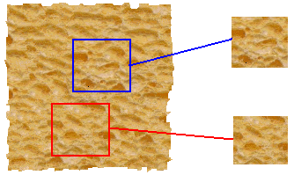
PREVIOUS WORK
input image
Models involving Texture Synthesis by estimating conditional distribution of a pixel through its neighbors. Local non-semantic methods struggle when missing parts of image are larger.
In Graphics, Nearest neighbor based scene completion using dataset of millions of images is used. [Hays & Efros 2007].
SYNTHESIS
True (infinite) texture
generated image

Slide 4
PROPOSED SOLUTION
Encoder – Decoder Convolution Network for reconstructing large missing regions based on context -
Encoder takes an input image with missing regions and produces feature representations.
Decoder – takes feature representations and produces missing image content.
Adversarial Network
Compares generated image with ground truth image to check the closeness to real image.

Slide 5
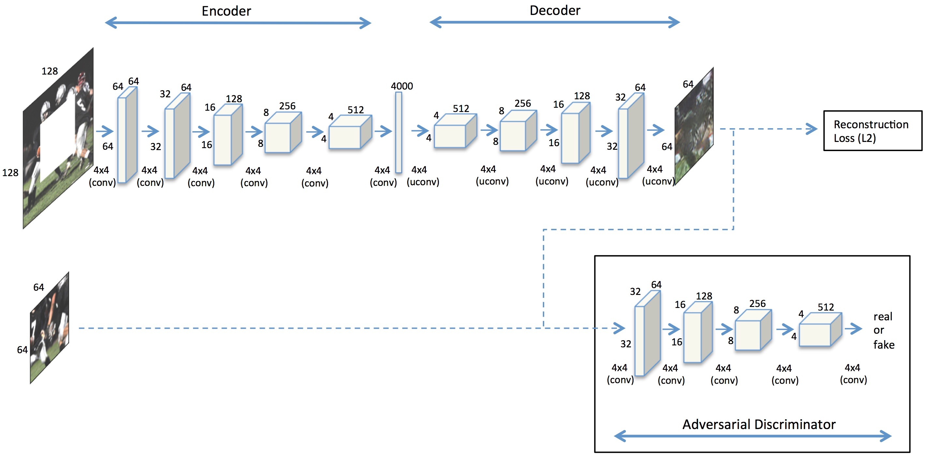
MODEL

Slide 6
DECOUPLED LOSS
Reconstruction Loss – for capturing overall structure of missing region and coherence with regard to its context.
Adversarial Loss – tries to make predictions look real by picking up a particular mode.

Slide 7
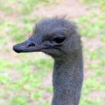
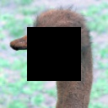
DATA DESCRIPTION
Input Images are of size 128x128 pixels.
Cropped to

Slide 8
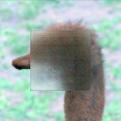
RESULTS
Results improve quickly with the number of epochs.
Sample Results for 1000 epochs.

Slide 9
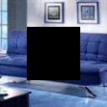
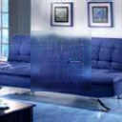
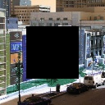
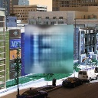
DISCUSSION
Images with non-uniform surroundings are harder to Inpaint
Uniform area around crop
Non-uniform area around crop

Slide 10
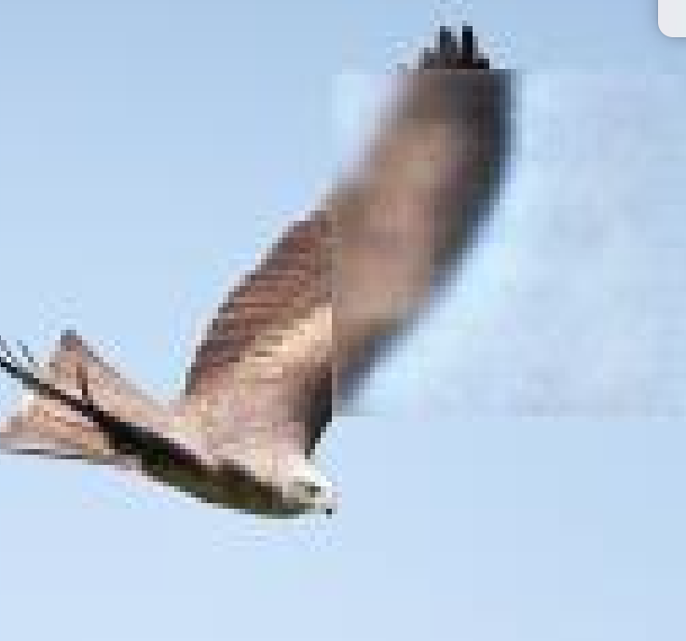
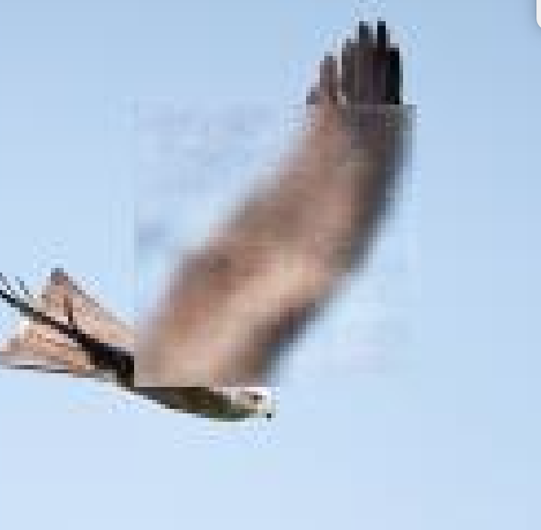
DISCUSSION
Images with center patches are harder to Inpaint then ones with random patches in general
Random Patches Inpaint with 100 epochs
Center crop Inpaint with 250
epochs

Slide 11
THANK YOU!

